Slide 1

ACCIDENTAL ANALYSIS
PRESENTED BY:
M N CHARITH REDDI
N AKSHAY REDDY
S SIVAKUMAR REDDY
P NITHEESH
B KIRAN REDDY

Slide 2
about
While the rate of fatal road accidents has been decreasing steadily since the 80s, the past ten years have seen a stagnation in this reduction.
Coupled with the increase in number of miles driven in the nation, the total number of traffic related-fatalities has now reached a ten year high and is rapidly increasing.
There are many inventories in in automobile industries to design and build safety measures for automobiles, but traffic accidents are unavoidable.
There is a huge number of accidents prevailing in all urban and rural areas.
Patterns involved with different circumstances can be detected by developing an accurate prediction models which will be capable of automatic separation of various accidental scenarios.

Slide 3
What’s the prediction?
To accomplish these tasks, we will make use of data wrangling, plotting, dimensionality reduction, and unsupervised clustering.
The data given to us was originally collected by the National Highway Traffic Safety Administration and the National Association of Insurance Commissioners.

Slide 4
TECHNICAL DESCRIPTION
In this analysis, we have used some algorithms that accomplish the complete task and certain circumstances.
k-nearest neighbors algorithm
Random forest algorithm
Logistic regression algorithm

Slide 5
K-nearest neighbour
In pattern recognition, the k-nearest neighbour (k-NN) is a non-parametric method used for classification and regression.
The output depends on whether k-NN is used for classification or regression:
In k-NN classification, the output is a class membership. An object is classified by a plurality vote of its neighbor, with the object being assigned to the class most common among its k nearest neighbor (k is a positive integer, typically small). If k = 1, then the object is simply assigned to the class of that single nearest neighbor.

Slide 6
Random forest
Random forests or random decision forests are an ensemble learning method for classification, regression and other tasks that operates by constructing a multitude of decision trees at training time and outputting the class that is the mode of the classes (classification) or mean prediction (regression) of the individual trees.
Random decision forests correct for decision trees' habit of overfitting to their training set.
Random forests are a way of averaging multiple deep decision trees, trained on different parts of the same training set, with the goal of reducing the variance.

Slide 7
Logistic regression
Logistic regression is a statistical model that in its basic form uses a logistic function to model a binary dependent variable, although many more complex extensions exist.
In regression analysis, logistic regression is estimating the parameters of a logistic model (a form of binary regression).
Mathematically, a binary logistic model has a dependent variable with two possible values, such as pass/fail which is represented by an indicator variable.

Slide 8
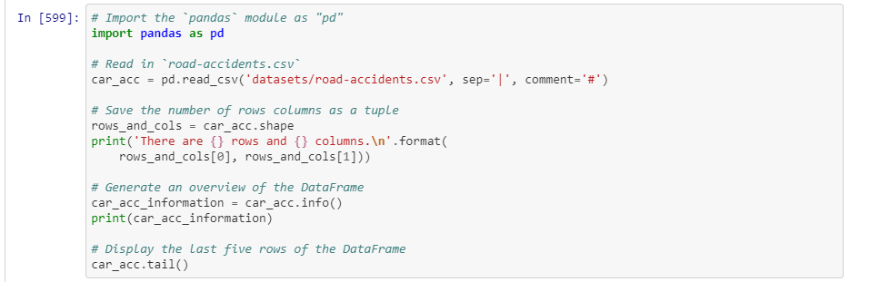
Importing packages and reading the csv file

Slide 9
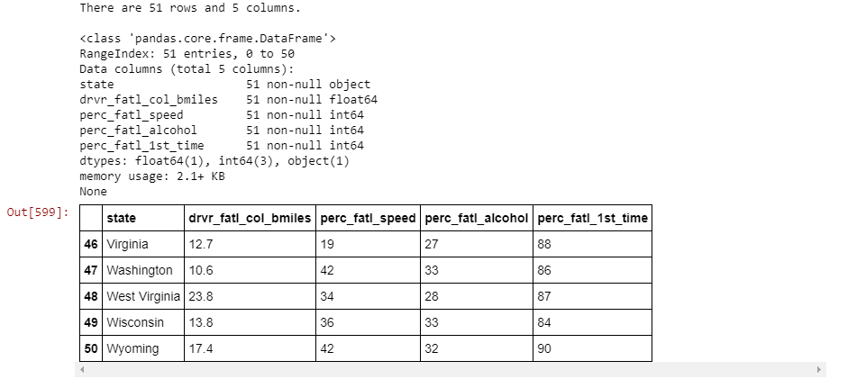
Table display

Slide 10
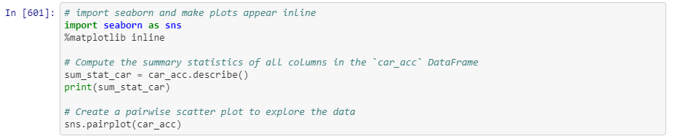
textual and a graphical summary of the data

Slide 11
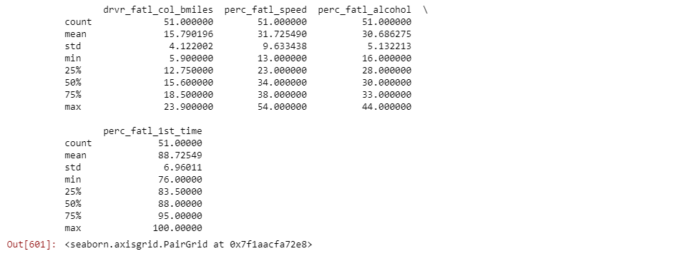
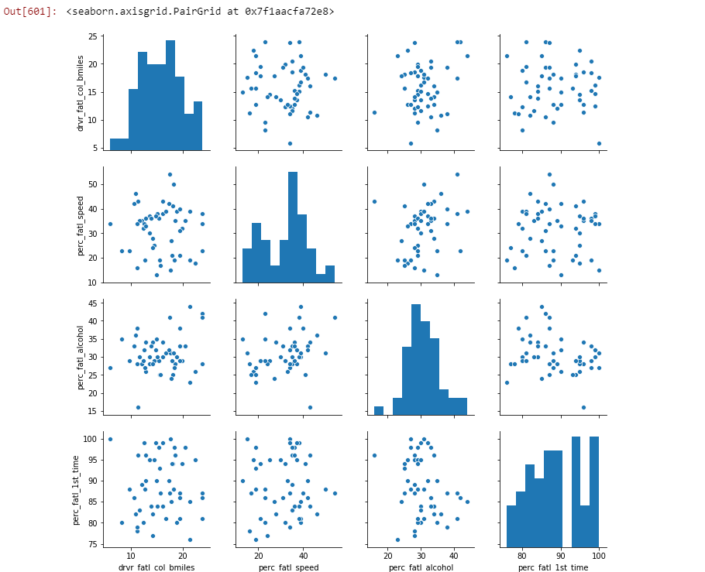
textual and a graphical summary of the data

Slide 12
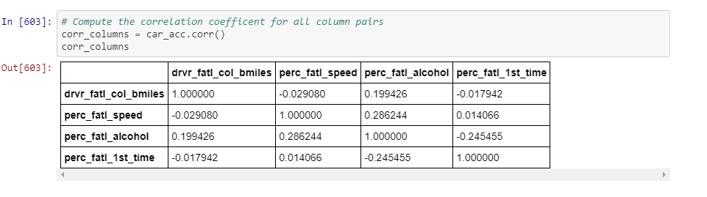
Correlation coefficient

Slide 13
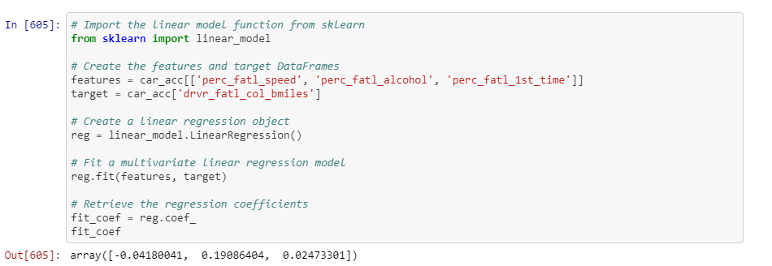
multivariate linear regression

Slide 14
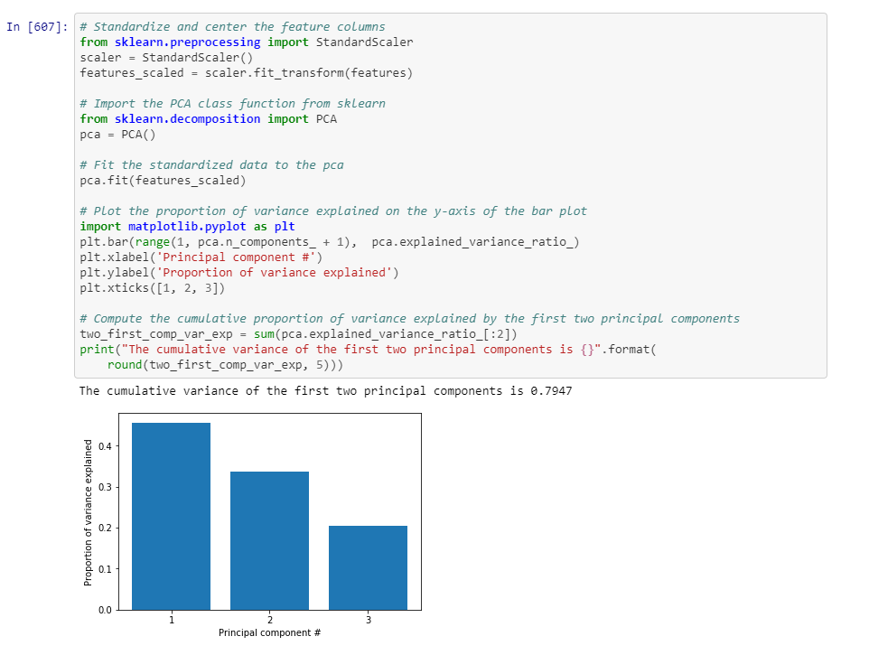
PCA on standardized data

Slide 15
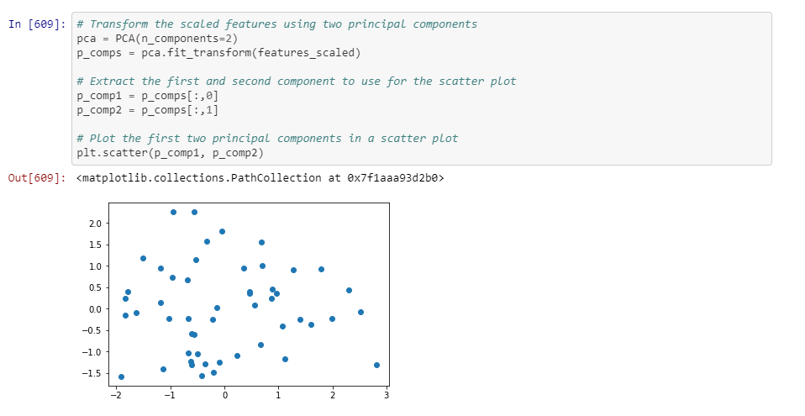
VISUALIZATION of the first two principal components

Slide 16
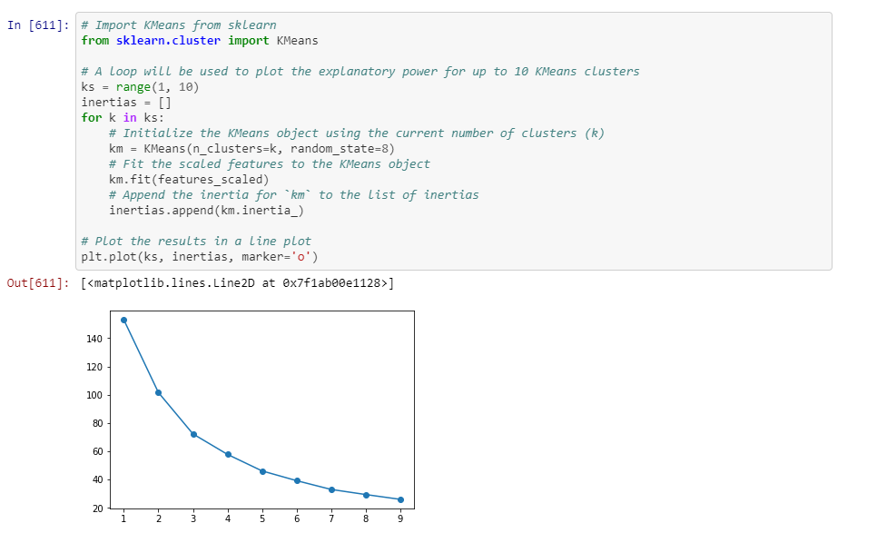
Find clusters of similar states in the data

Slide 17
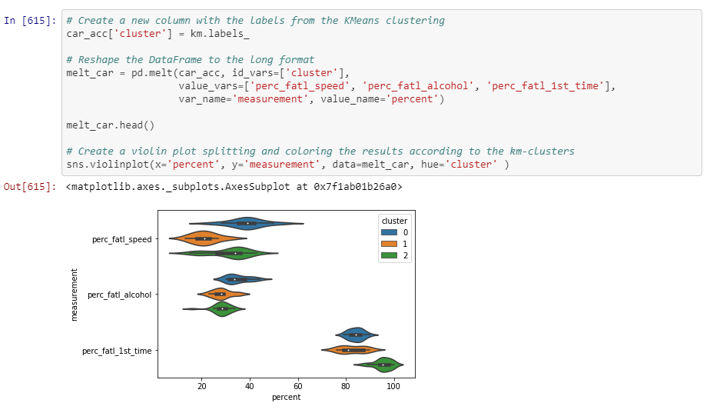
Visualize the feature differences between the clusters

Slide 18
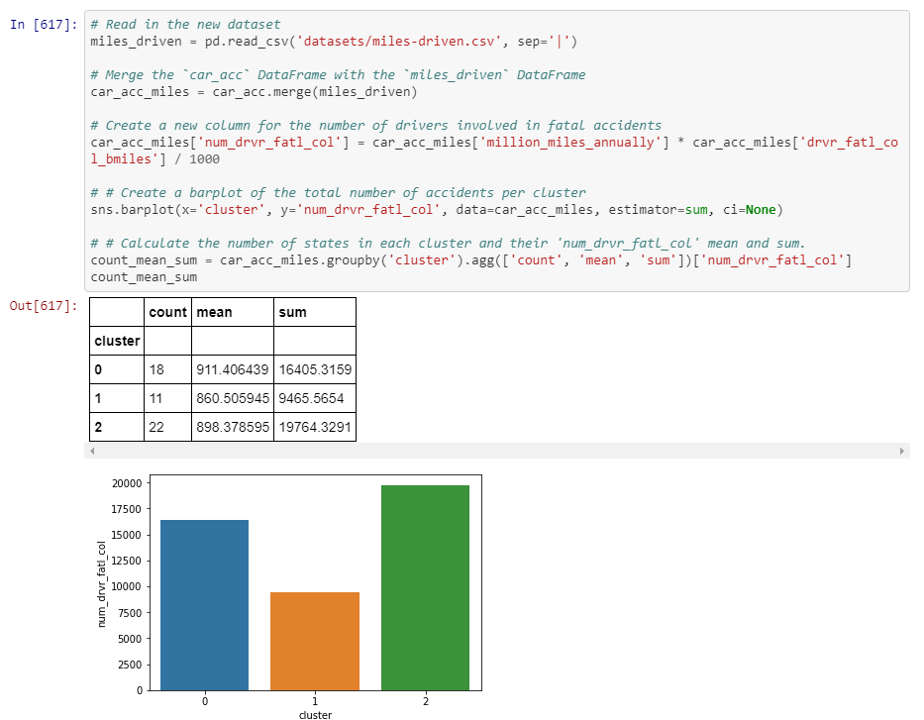
Compute the number of accidents within each cluster

Slide 19
Make a decision when there is no clear right choice
As we can see, there is no obvious correct choice regarding which cluster is the most important to focus on. Yet, we can still argue for a certain cluster and motivate this using our findings above. Which cluster do you think should be a focus for policy intervention and further investigation?
In [619]:
# Which cluster would you choose? cluster_num = 2

Slide 20
Thank you

